Slide 1
QX4004 – Molecules to Materials
Rotation 1 – Question Set 3

Slide 2
1) Draw the overlap of atomic orbitals leading to the formation of molecular orbitals in the following cases (draw the shapes of the atomic orbitals and all their respective molecular orbitals, with attention to orbital phase, position of nuclei and nodes): i) 1s + 2p ii) 2p + 2p (frontal overlap) iii) 2p + 2p (lateral overlap)

Slide 3
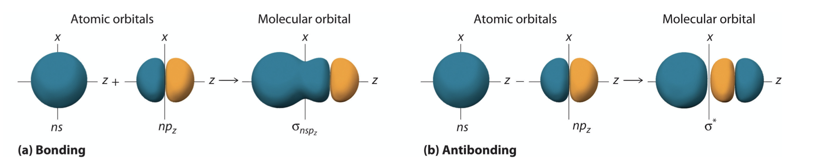
1) Draw the overlap of atomic orbitals leading to the formation of molecular orbitals in the following cases (draw the shapes of the atomic orbitals and all their respective molecular orbitals, with attention to orbital phase, position of nuclei and nodes): i) 1s + 2p

Slide 4
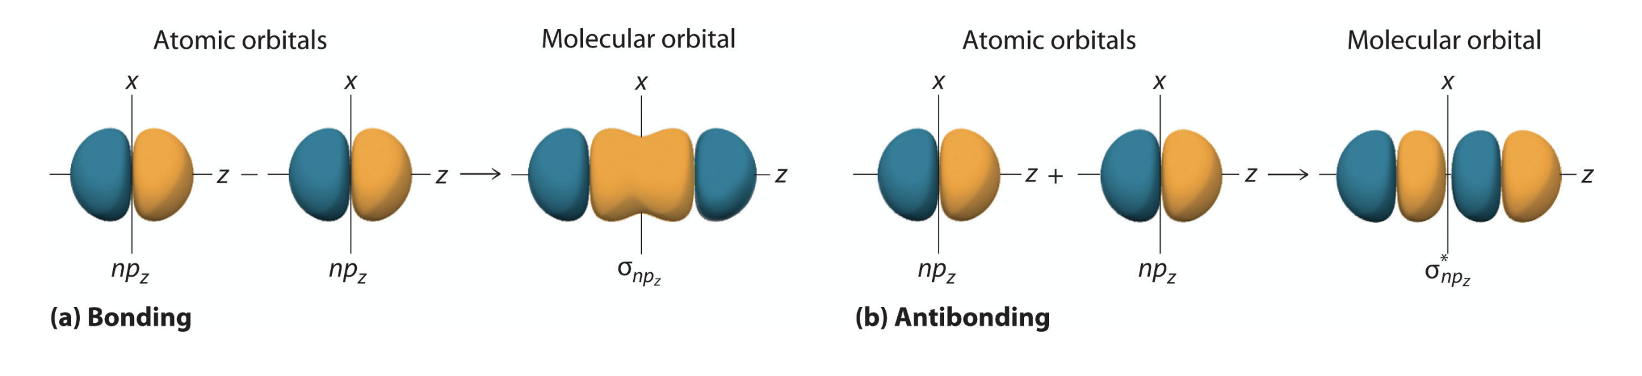
1) Draw the overlap of atomic orbitals leading to the formation of molecular orbitals in the following cases (draw the shapes of the atomic orbitals and all their respective molecular orbitals, with attention to orbital phase, position of nuclei and nodes): ii) 2p + 2p (frontal overlap)

Slide 5
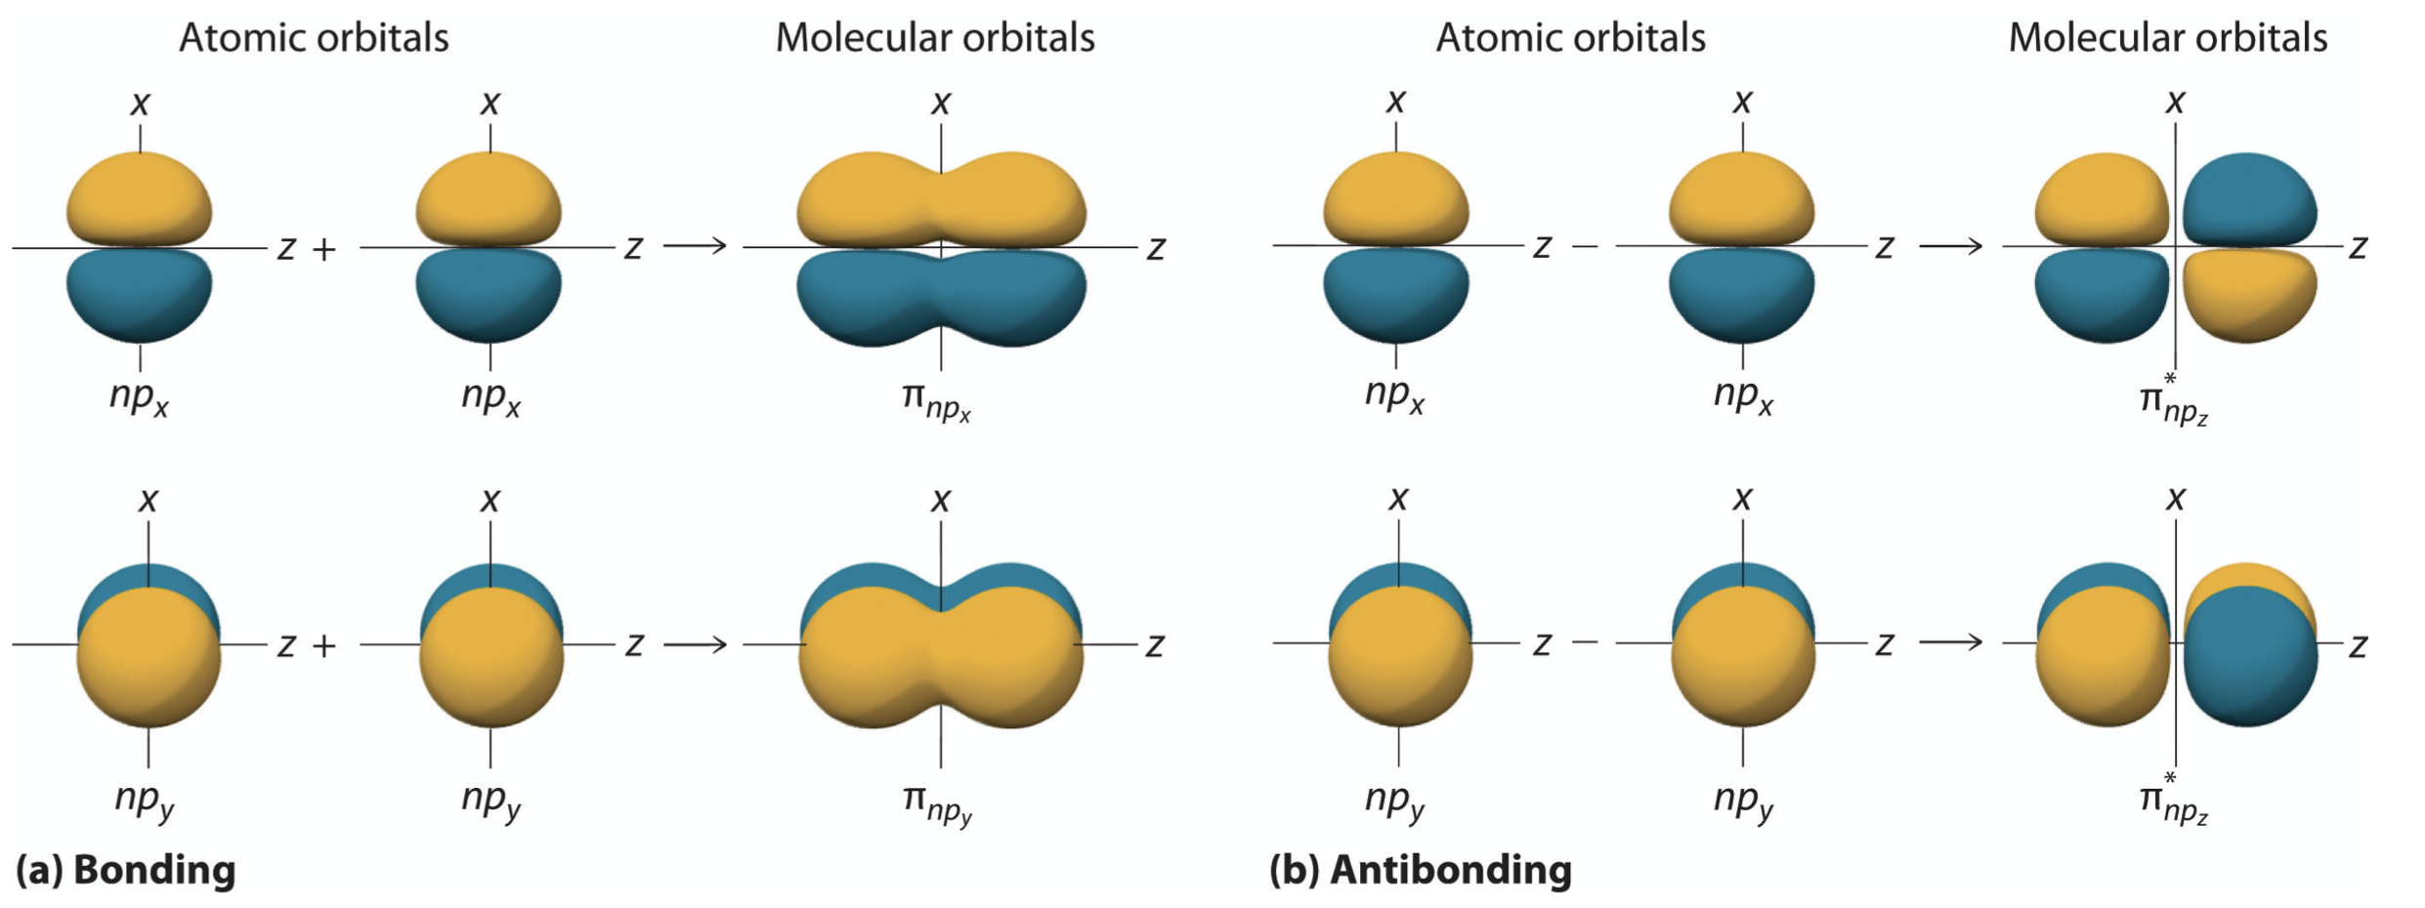
1) Draw the overlap of atomic orbitals leading to the formation of molecular orbitals in the following cases (draw the shapes of the atomic orbitals and all their respective molecular orbitals, with attention to orbital phase, position of nuclei and nodes): iii) 2p + 2p (lateral overlap)

Slide 6
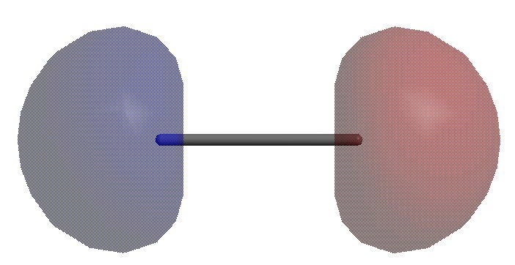
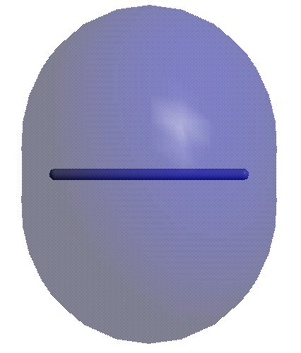
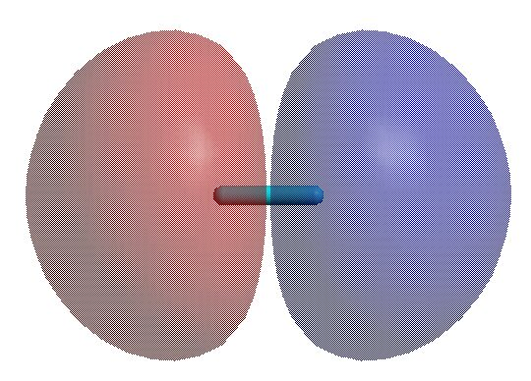
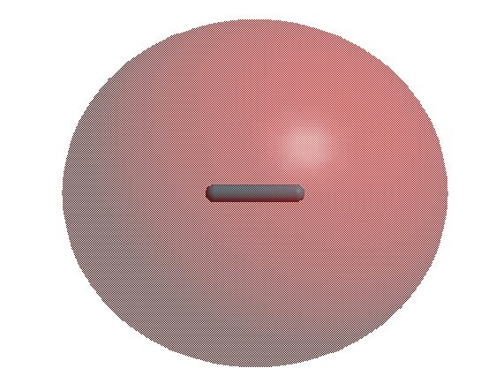
2) Draw a molecular orbital diagram for a Be₂ molecule and comment on whether this molecule could exist.
Be
Be₂
Be
2σ*
The bond order in Be₂ is (4-4)/2 = 0,
so the molecule can not exist.
2s
2s
2σ
Energy
1σ*
1s
1s
1σ

Slide 7
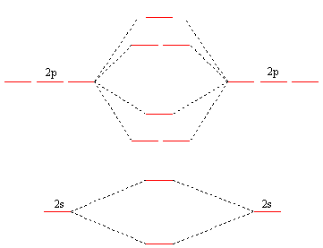
3) Draw the energy diagram for the molecular orbitals of the N₂ molecule (include the atomic orbitals of each atom and the electrons provided by each atom, consider exclusively the valence shell). Label each type of orbital correctly. Calculate the bond order.
σ*
π*
The bond order in N₂ is (8-2)/2 = 3
σ
π
σ*
σ

Slide 8
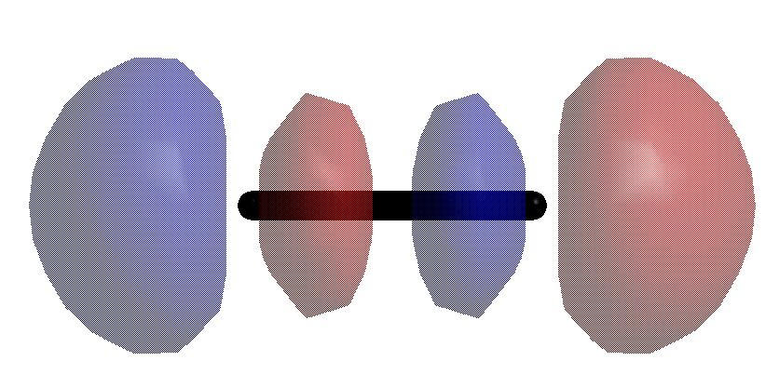
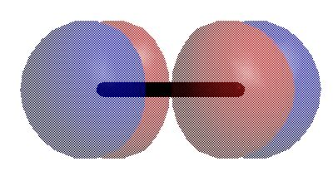
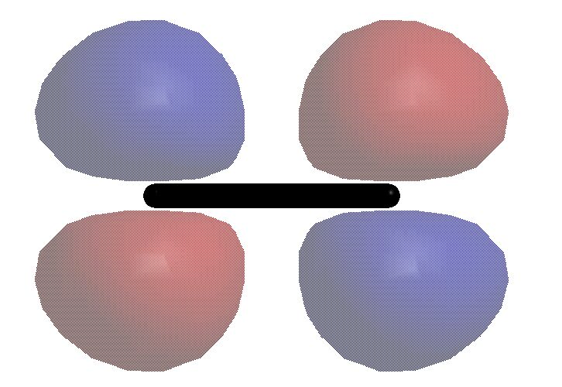
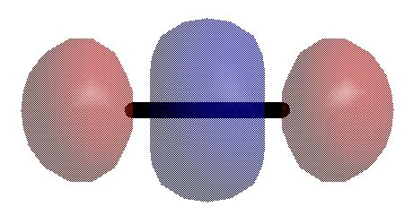
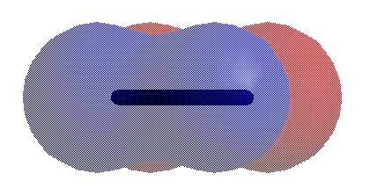
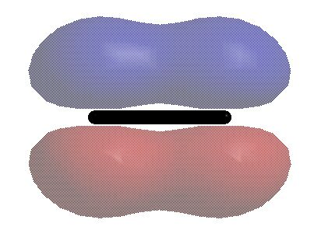
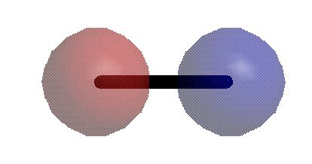
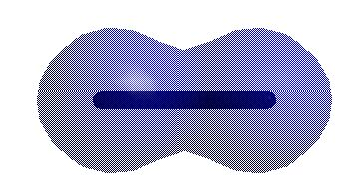
4) Draw all the molecular orbitals considered in Q3 (show clearly how they form through the overlap of the corresponding atomic orbitals). Indicate clearly orbital shape, phases, position of nuclei and nodes.
N
N₂
N
σ*
π*
2p
(p_{x},p_{y})
2p
p_{z}
Energy
σ
π
σ*
2s
2s
σ

